Slide 1
Worcap System

Slide 2
Features
Managing (Server side)
Track Time with Screenshots
Work Details
Organize your Projects and Users
Role and Permission Control
Individualized User Settings

Slide 3
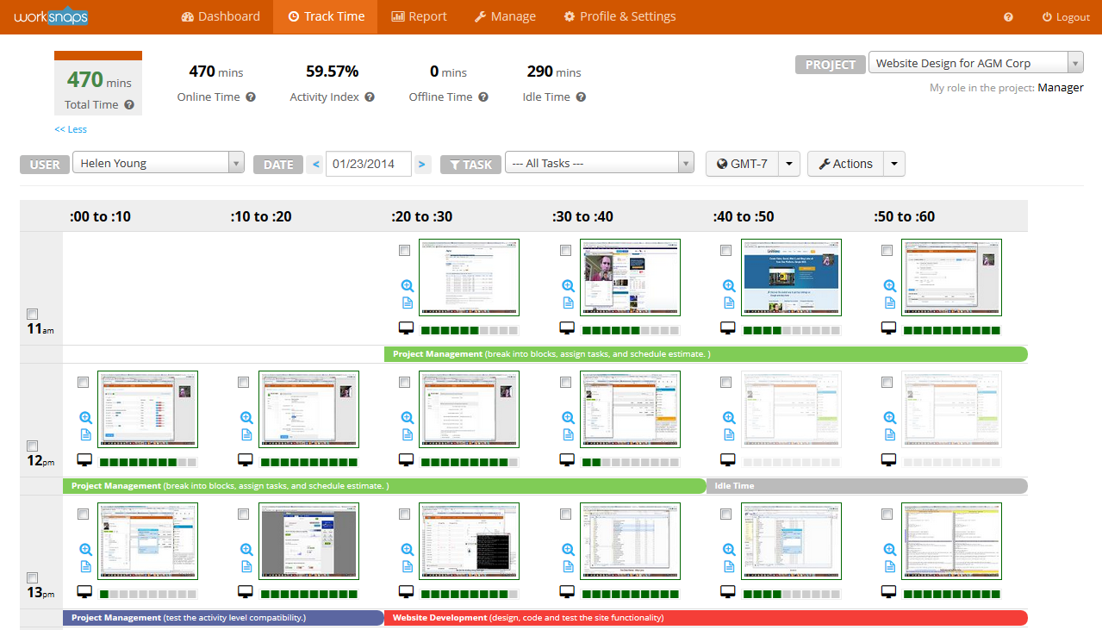
Track Time with Screenshots
Worcap system is about tracking the working hours of an employee with their work details of what they have done in the particular date and time and verified it by image through screenshots. Screenshots is being done every 10 minutes and send it to the server/admin page (Website).

Slide 4
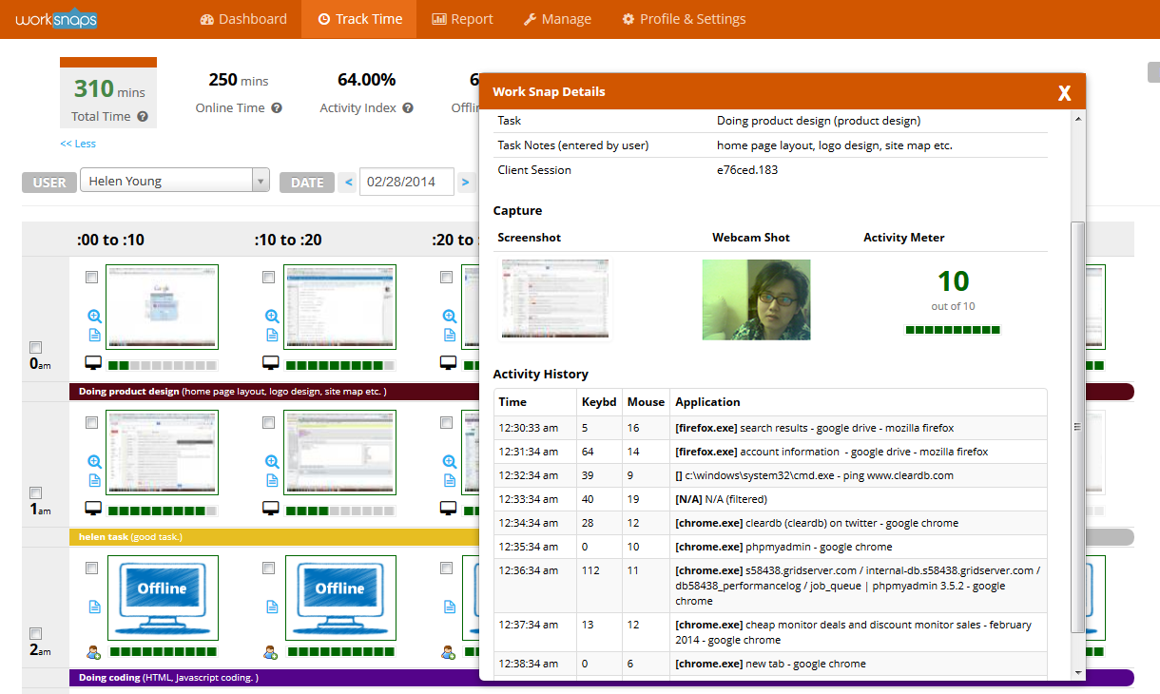
Work Details
Worcap system tracks everything. It identify the number of mouse and keyboard click each minute by the users/employee. It also determine what are the applications are being opened/used each minute.

Slide 5

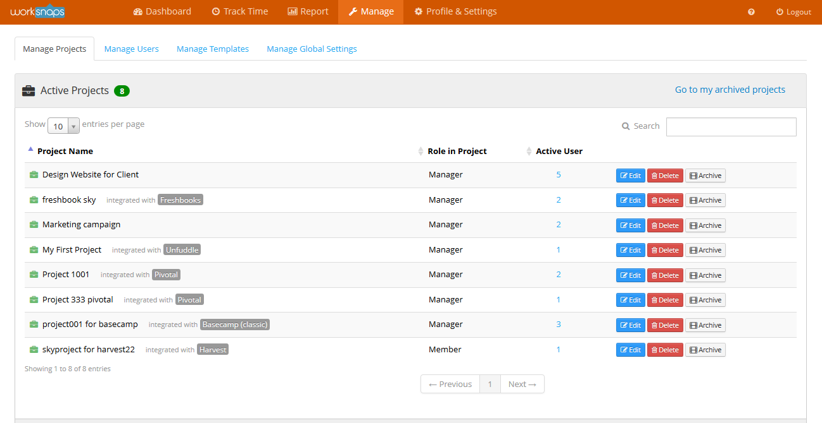
Projects and Users
Worcap system allows admin to manage projects and users. Managing users is about assigning employee to a particular project and given a task to be done. Managing projects include the name of the project, description, task, users belong to the particular project and more….

Slide 6

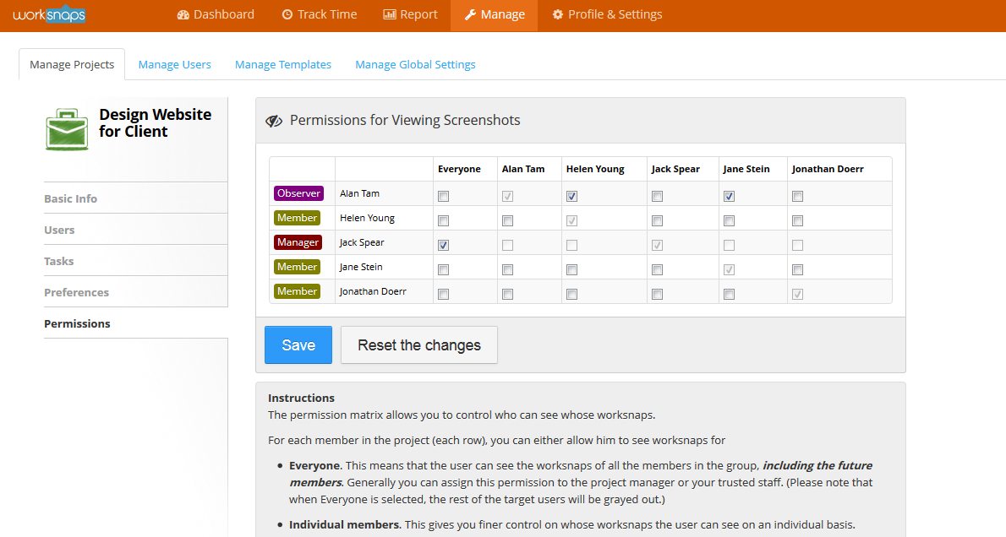
Role and Permission Control
Worcap system also allows admin(Owner of the project) user to set the permission level of each member users in viewing other’s screenshots and work details (Allow or Not Allowed).
Worcap also allows admin users to set the role of every users/participants in the project:
Member
Manager
Observer

Slide 7

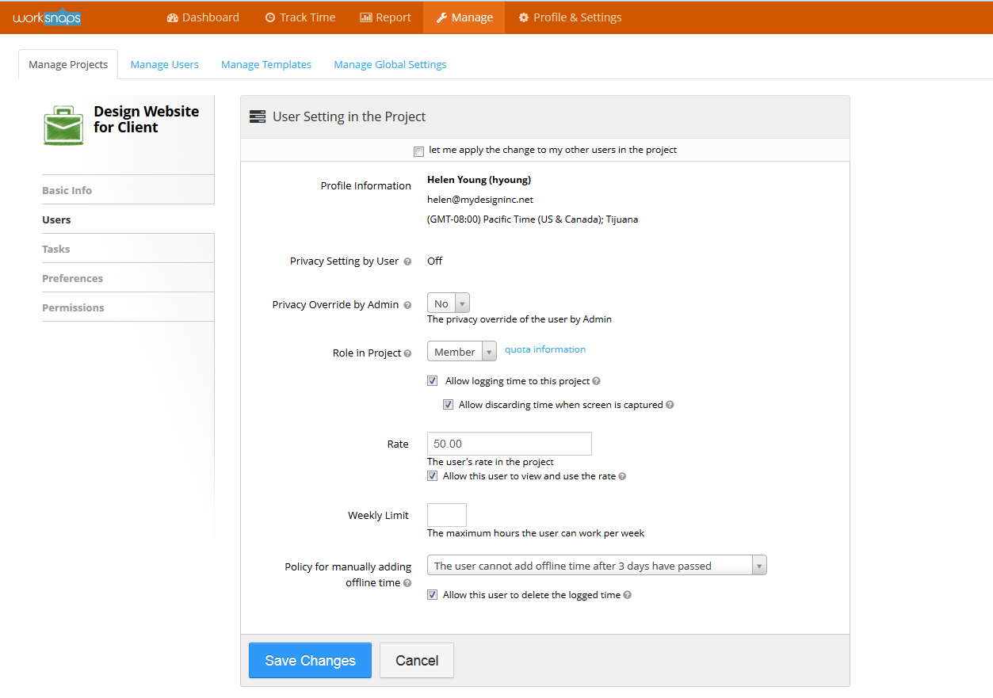
Individualized User Setting
Every users in this system can set the behavior of Worcap system when tracking time so that it can best suite the user’s work style and your organizational policy.

Slide 8
Features (cont..)
Client
Light Weight Client
Friendly Notification
Flexible Configuration
Connection Resilience

Slide 9
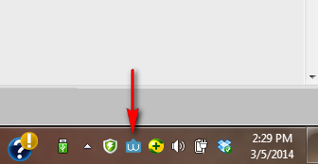
Light Weight Client
Worcap system has a desktop application which we called client. It can run silently in the background(System Tray) and it’s icon can be located in your task bar. This will not give a big task to your computer. It will be more easier for your computer to run faster.

Slide 10
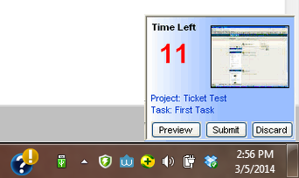
Friendly Notification
In this part of our system, this can be done when ready to screenshot is taken and ready to be sent to the server. Friendly notification is being done through notifying user with a countdown timer. The user can choose 3 options either to 1.)Preview the image, 2.) Submit the image (screenshot) or 3.) Discard it.

Slide 11
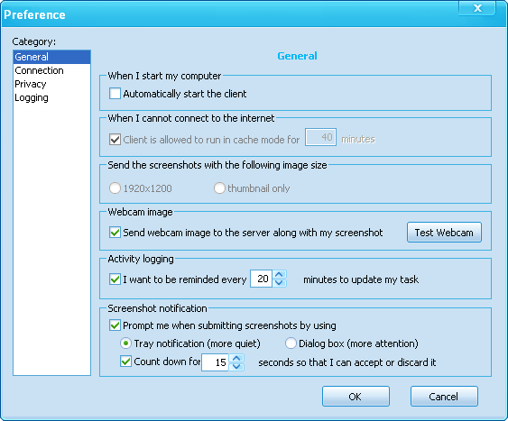
Flexible Configuration
User is free to configure Worcap system in order to meet the user’s work habit and preference like:
Whether the user wants to be notified when a screenshot is taken.
Duration time of the notification dialog on screen.
Configure the connection properties
Whether to auto start the Light Weight Client or not.

Slide 12
Connection Resilience
Worcap system is the best and perfect tool for remote work. It determines if the connection is established or not. Because in case that the Light Weight Client cannot communicate to the server or there is no network connection, it stores the data(screenshot and work details) in a local hard drive and transmits it to the server once the connection is being re-established.

Slide 13
Features (cont..)
Reporting
Comprehensive Dashboard
Customized Reports
Advanced Tools

Slide 14
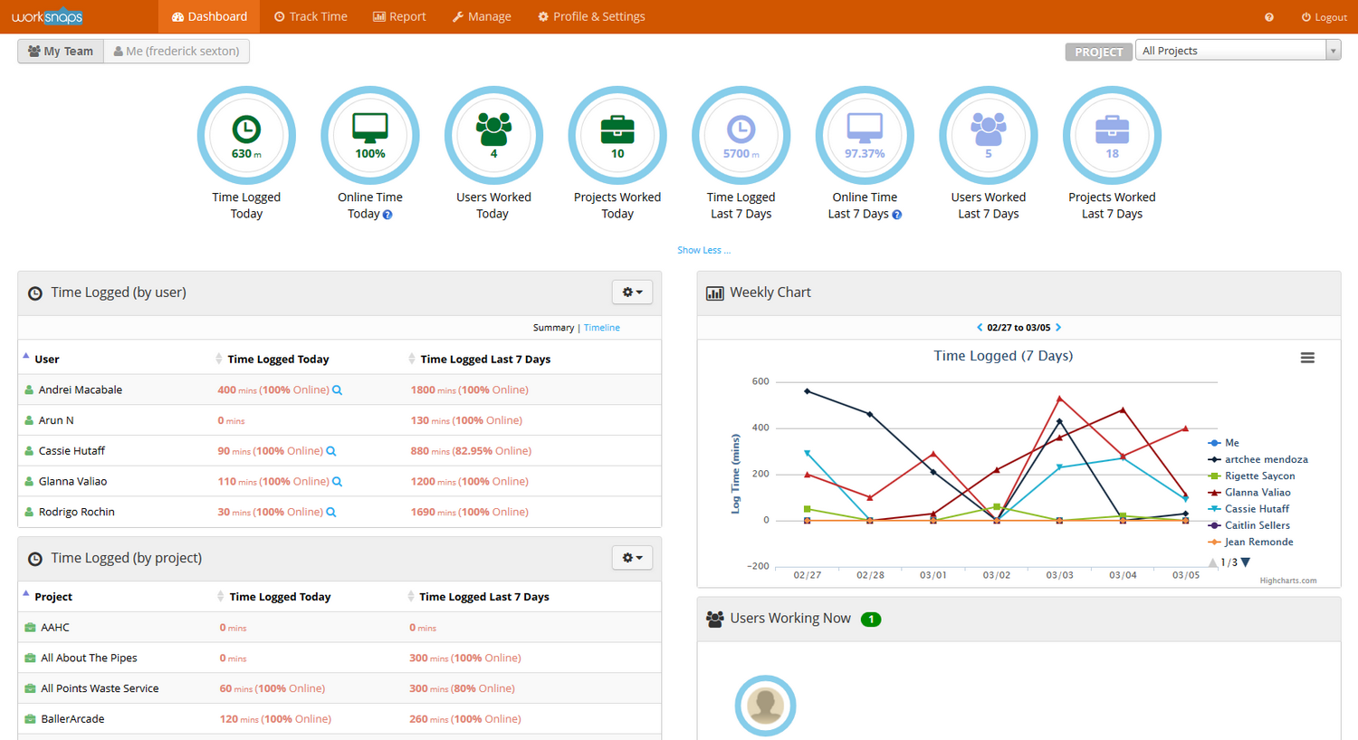
Comprehensive Dashboard
In this page, users can see the overview of all activities being done by the participants of every projects. Users can see everything up-to-date all projects and user activities. In this page, user may know the working hours of a specific participant in a specific project.

Slide 15
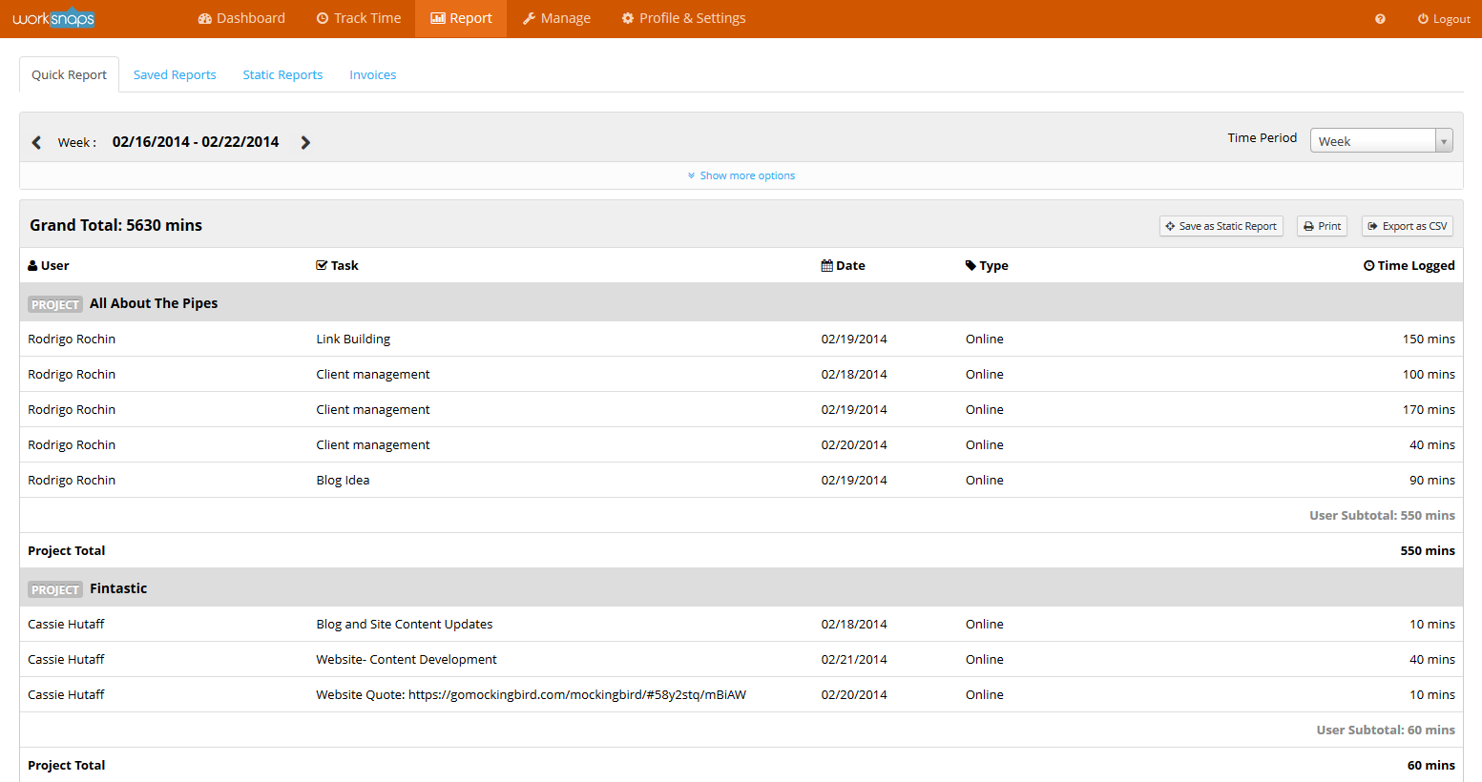
Customized Reports
In this page of site, we can see here details by details about the reports of working hours and grand total minutes by the participant. If you are an admin, you can see all the working hours of all your participants. Users can also create saved reports and help you run detailed reports for your team across several projects.

Slide 16
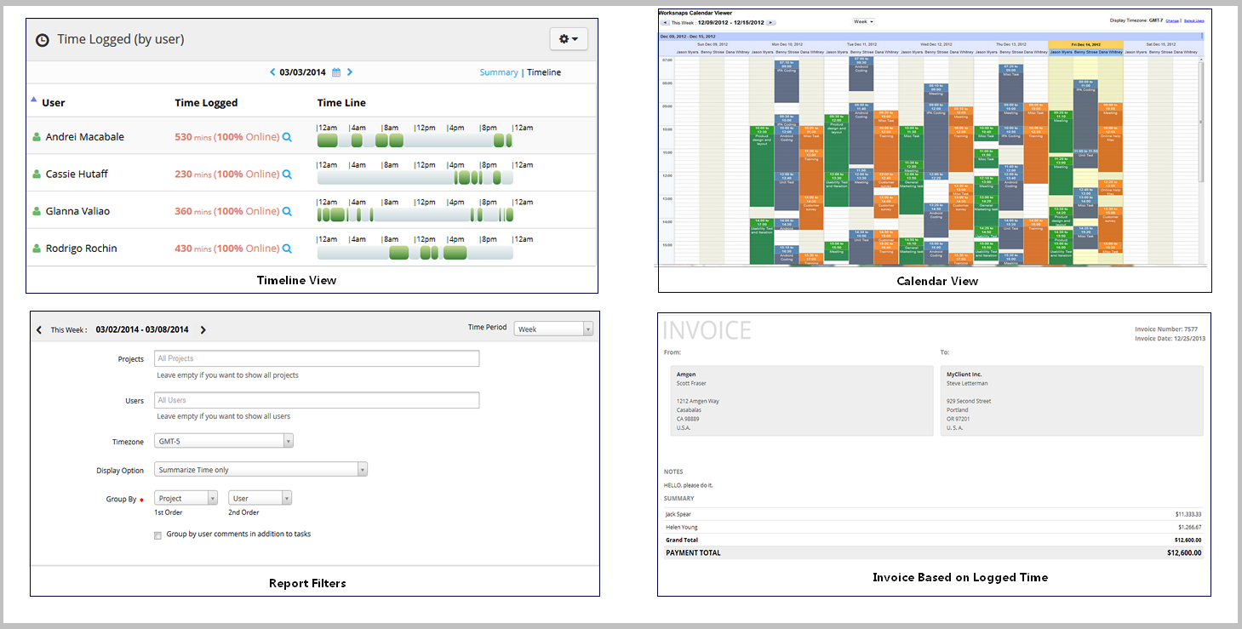
Advanced Tools
Worcap system has an advanced tool that tells the user about the logged time of a user in a particular project represent by Calendar viewer, Timeline Viewer and others.

Slide 17
Features (cont..)
Privacy
User has Full Control
Private Mode
Privacy Filters

Slide 18
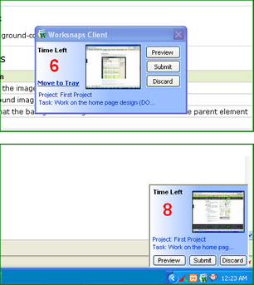
User has Full Control!
In this system, every time a screenshot is taken and ready to be sent to the server, the user will be notified. The user can decide to approve or deny the submission of screen shot. Users can also easily suspend the application(Light Weight Client) when necessary and resume it at a later time.

Slide 19
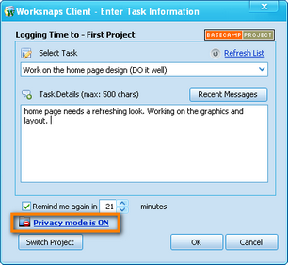
Private Mode
Users has a freedom either to set to Private Mode or not. Setting to private mode will keep the screen shots be visible only to the current user and will not be visible even to the owner of the project.

Slide 20
Privacy Filters
Every user has the permission in setting up the privacy filters in order to avoid the submission of sensitive information to the server.

